Slide 1
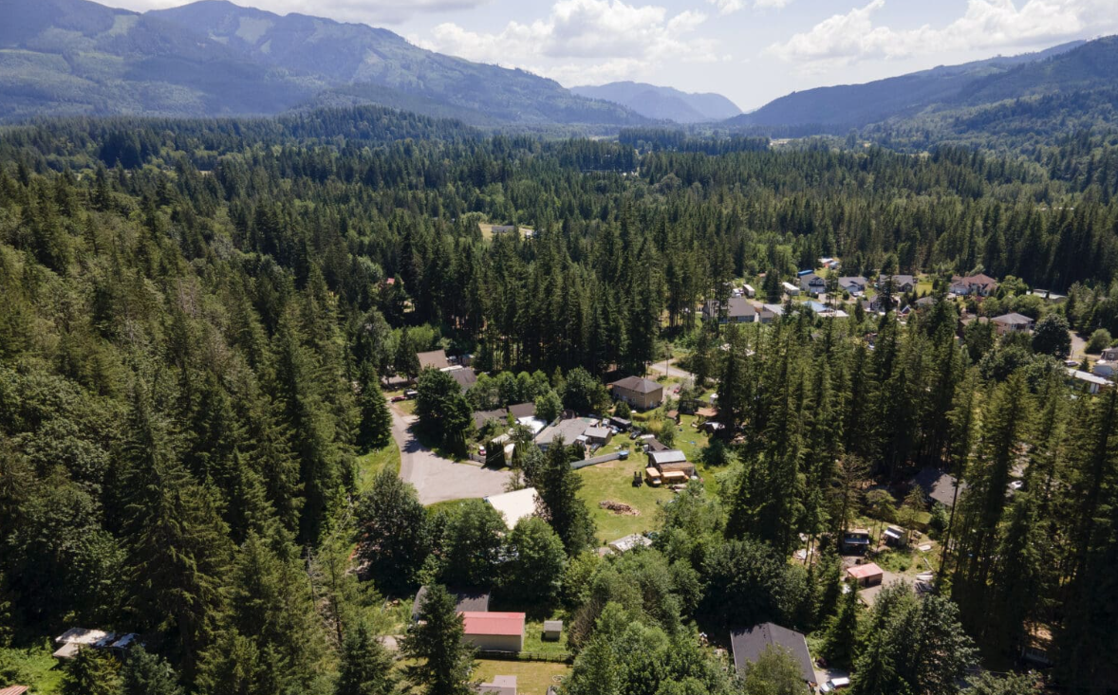

Whatcom Water District No. 13
General Sewer Plan Discussion
February 11, 2026

Slide 2
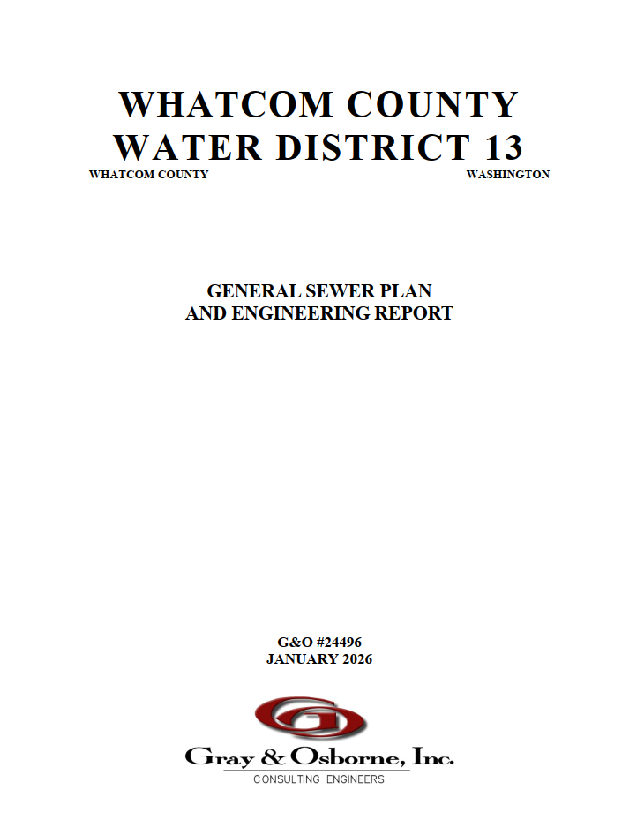
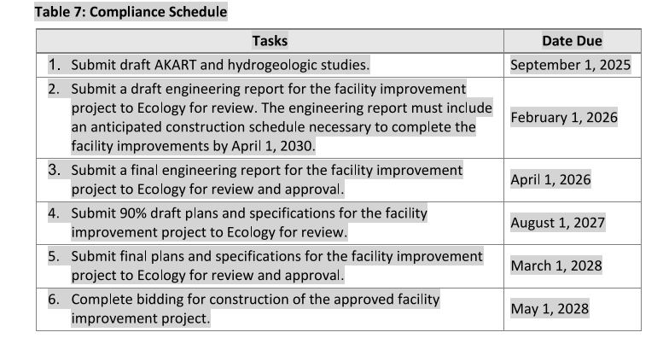
WCWD13 – Requirements for WWTP

Slide 3
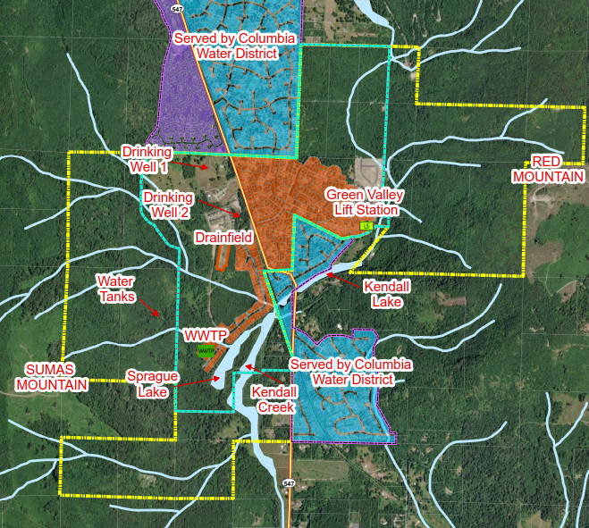
WCWD13 Sewer Service Area

Slide 4
Growth Projections
Growth |  |  |  | Flow | Loadings
Year | Population | Employment | ERUs | Average Annual Flow (gal) | BOD (lb/d) | TSS (lb/d) | TKN (lbs/d)
2025 | 1,045 | 36 | 470 | 53,400 | 214 | 214 | 34
2030 | 1,275 | 57 | 578 | 71,400 | 264 | 264 | 42
2035 | 1,505 | 91 | 690 | 92,100 | 315 | 315 | 50
2040 | 1,735 | 144 | 809 | 116,000 | 369 | 369 | 59
2045 | 1,964 | 228 | 937 | 143,700 | 427 | 427 | 68
2065 | 2,849 | 578 | 1,442 | 221,100 | 658 | 658 | 105

Slide 5
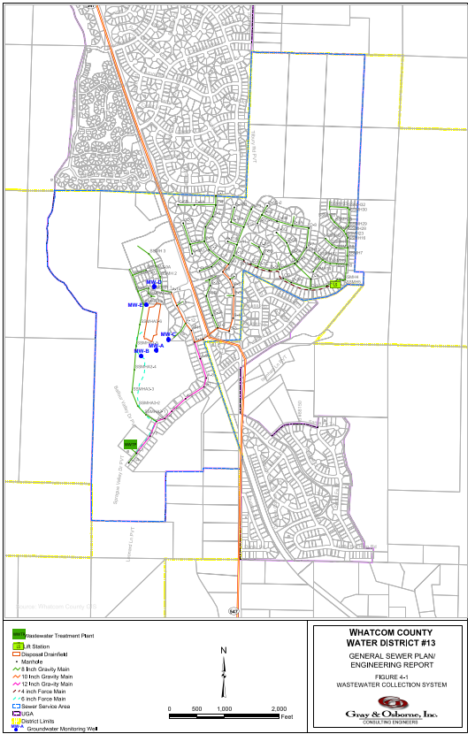
Collection System
Projects (2025-2045)
Collection System Cleaning/TV Inspection of 20,000 LF of pipes (2030-2039) Estimated total cost: $70,000
Green Valley Lift Station Upgrade (2030) Estimated total cost: $1,055,000

Slide 6
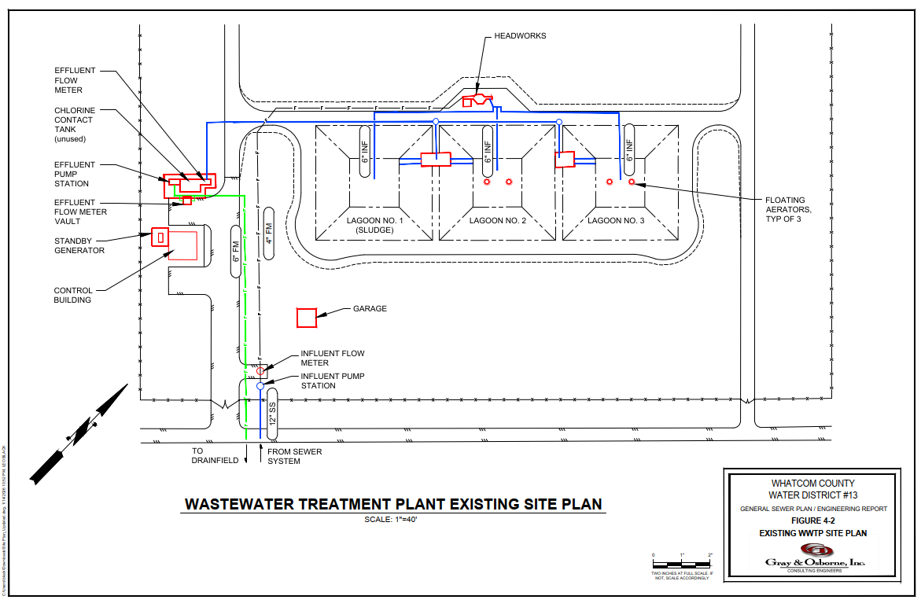
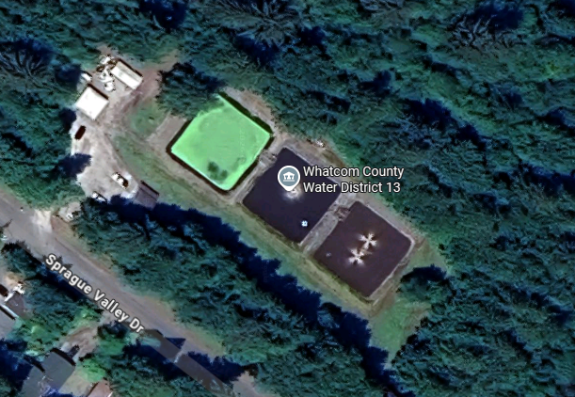
Wastewater Treatment Plant (WWTP)

Slide 7
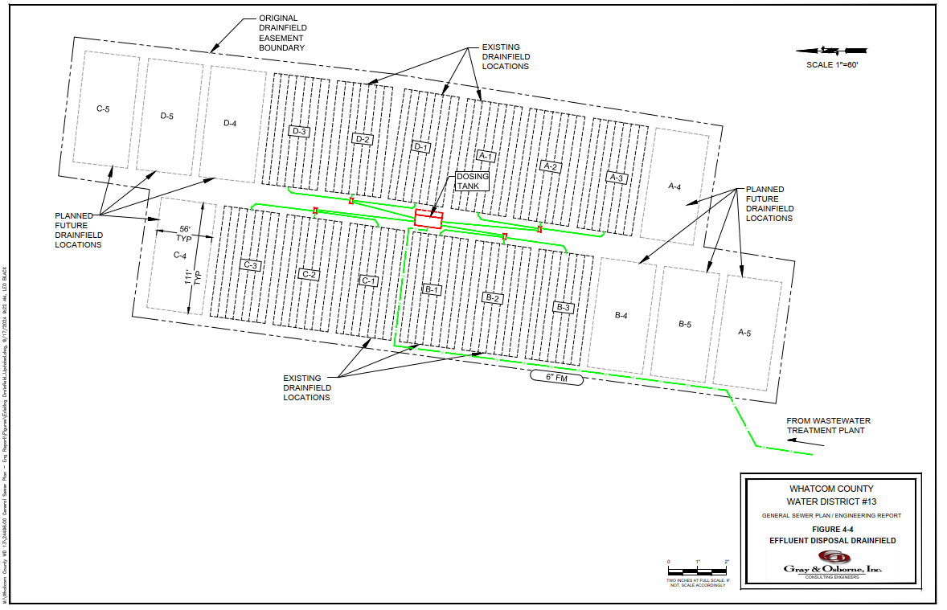
Effluent Drainfield

Slide 8
State Waste Discharge (SWD) Permit
Summary of SWD Permit ST0007367 Groundwater Limits
Parameter | Maximum Limit
Nitrate (as N) | Background concentration + 0.20 mg/L
Sulfate | 265 mg/L
Total Dissolved Solids | Background concentration + 3.26 mg/L
Total Coliform Bacteria | 1 cfu/100 mL
Chloride | 9.25 mg/L
Parameter | Minimum | Maximum
pH | 6.5 standard units | 8.5 standard units
Summary of SWD Permit ST0007367 Effluent Limits
Parameter | Average Monthly | Average Weekly
5-Day Biochemical Oxygen Demand (BOD₅) | 45 mg/L 47 lbs/day 65% removal of influent | 65 mg/L 68 lbs/day
Total Suspended Solids (TSS) | 45 mg/L 47 lbs/day 65% removal of influent | 65 mg/L 68 lbs/day
Parameter | Minimum | Maximum
pH | 6.0 standard units | 9.0 standard units

Slide 9
SWD Compliance Schedule

Slide 10
WWTP Issues
Plant is currently over capacity
Effluent quality is frequently poor and does not meet permit limits
Does not meet current technology standards (AKART)
Must be upgraded to accommodate growth
Aging facilities -many components in poor condition
Does not provide flexibility to meet future standards

Slide 11
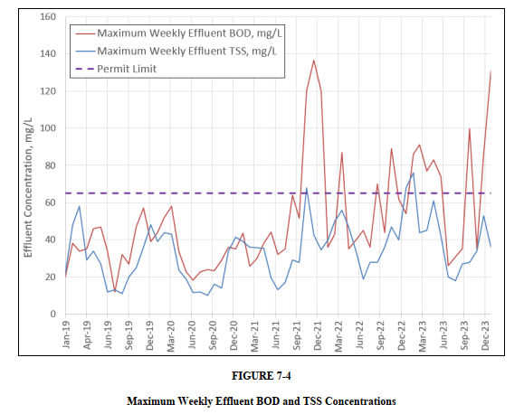
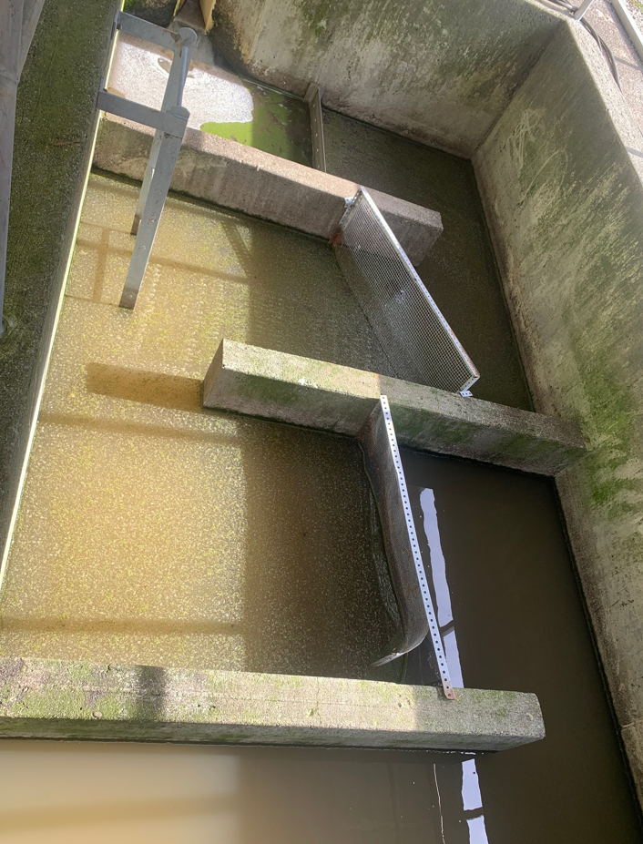
Effluent Quality

Slide 12
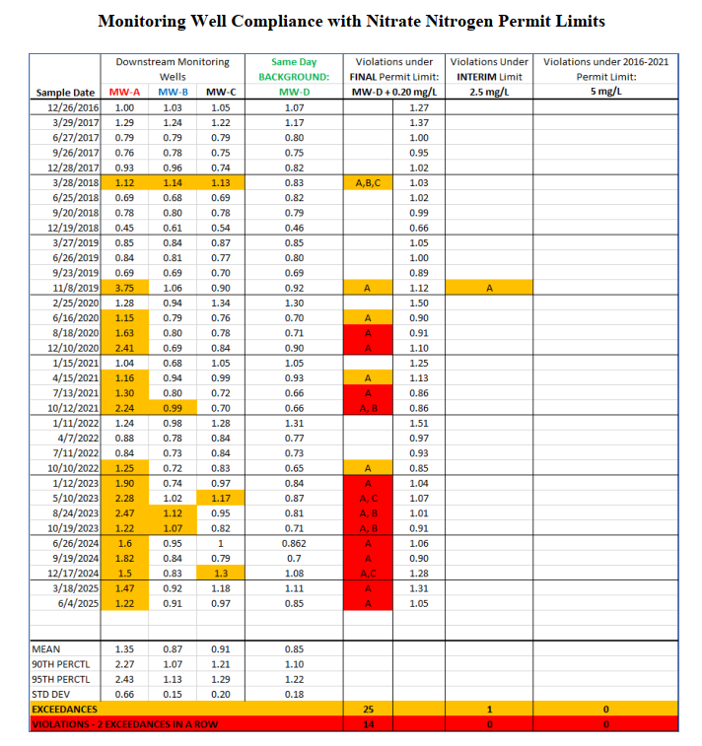
Effluent Quality
Compare Interim Limits vs. Final Limits
No exceedances or violations under prior permit
Groundwater is still protected

Slide 13
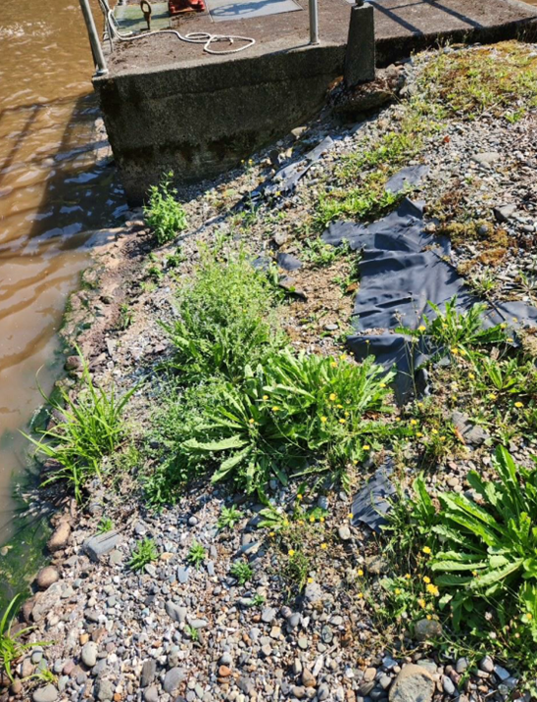
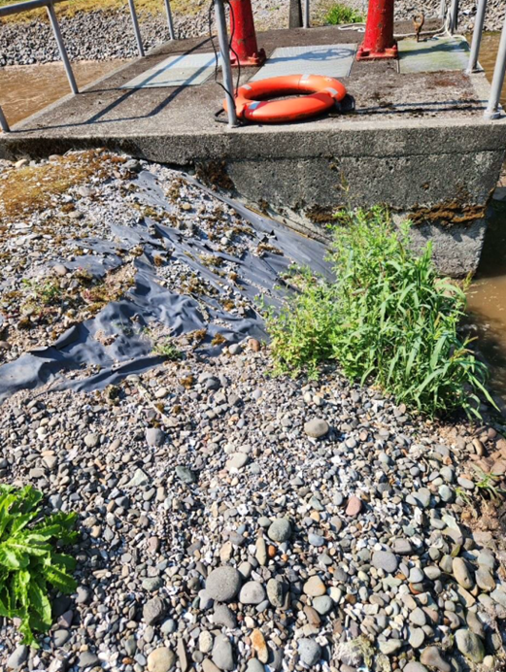
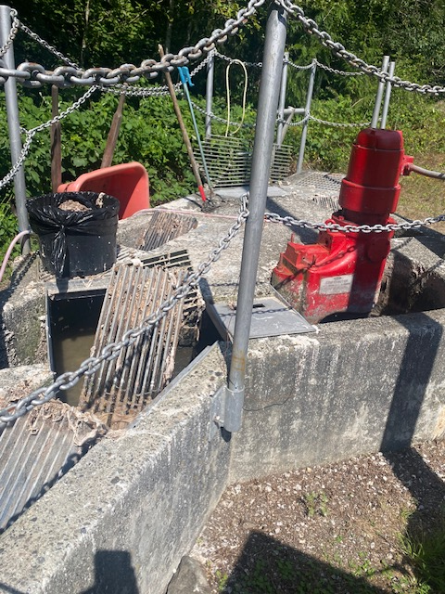
WWTP Condition – Headworks & Lagoon Liners

Slide 14
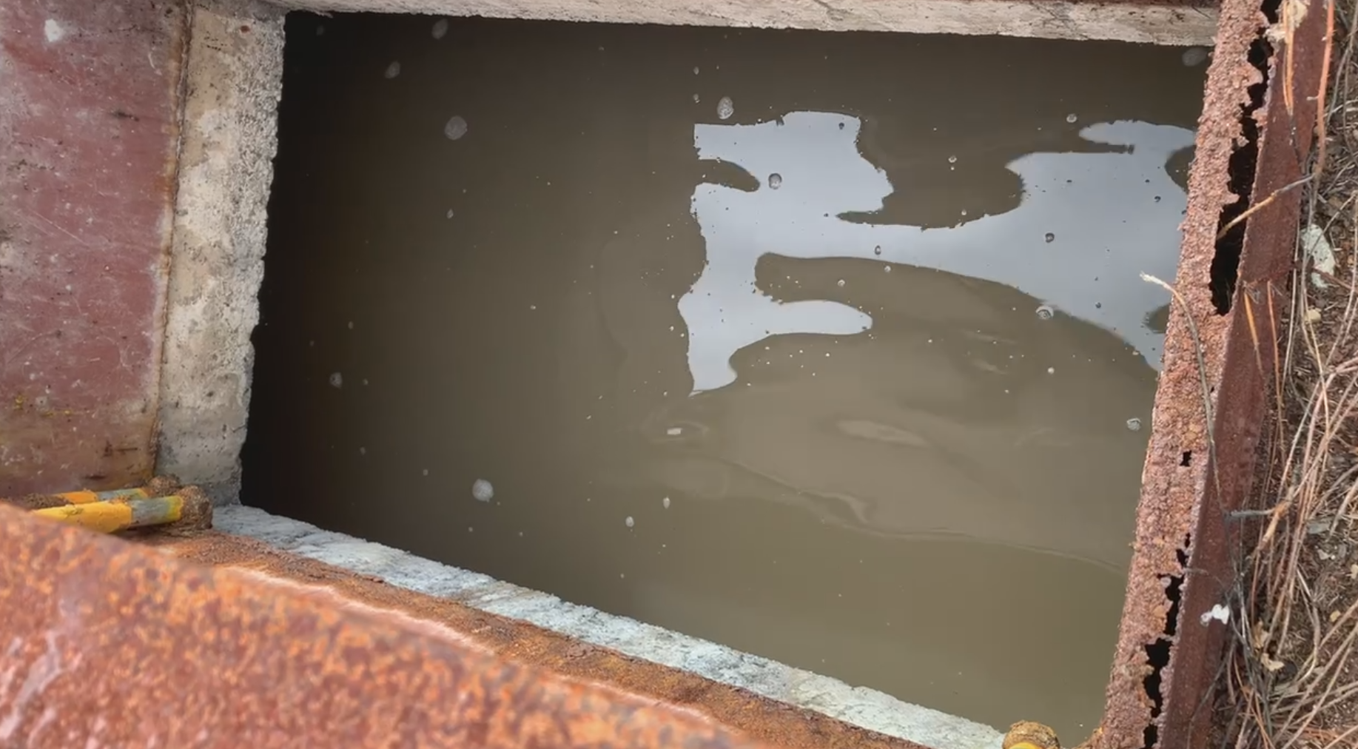
WWTP Condition – Effluent Distribution Boxes

Slide 15
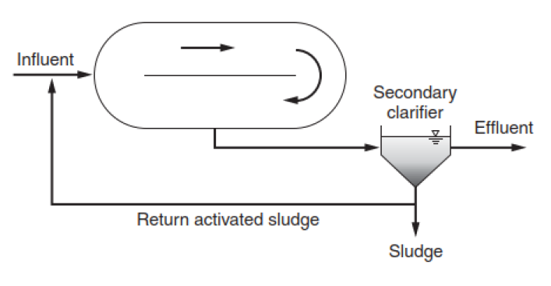
ALTERNATIVE 1 – OXIDATION DITCH PROCESS

Slide 16
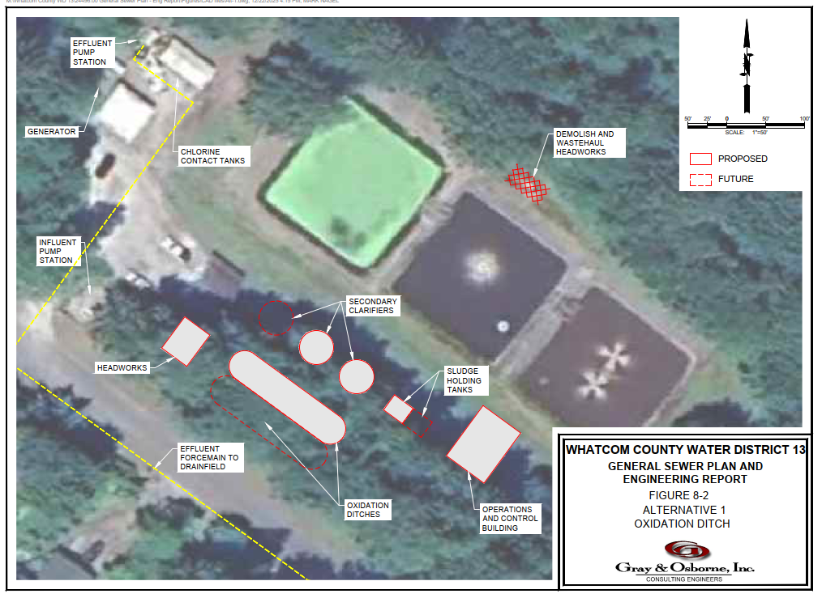
ALTERNATIVE 1 – OXIDATION DITCH PROCESS
Estimated
Capital Cost
$18.1 M

Slide 17
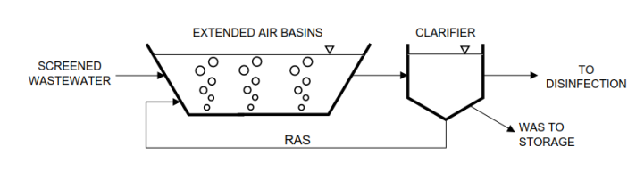
ALTERNATIVE 2 – AEROMOD SEQUOX CAS

Slide 18
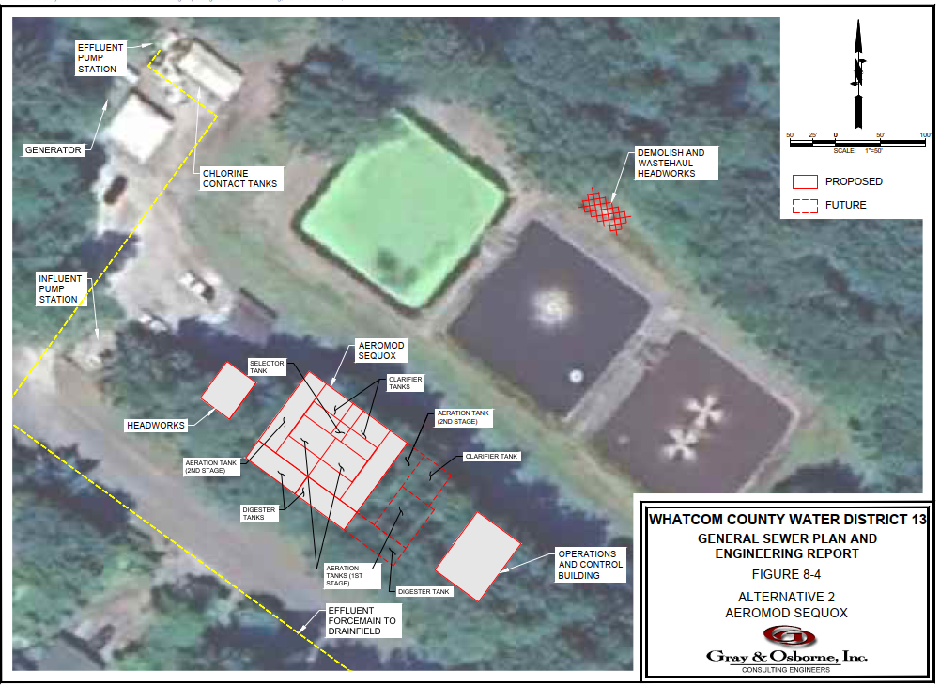
ALTERNATIVE 2 – AEROMOD SEQUOX CAS
Estimated
Capital Cost
$18.0 M

Slide 19
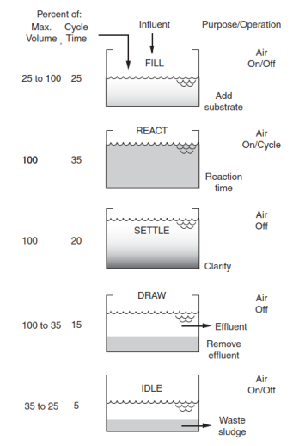
ALTERNATIVE 3 – SEQUENCING BATCH REACTOR (SBR)

Slide 20
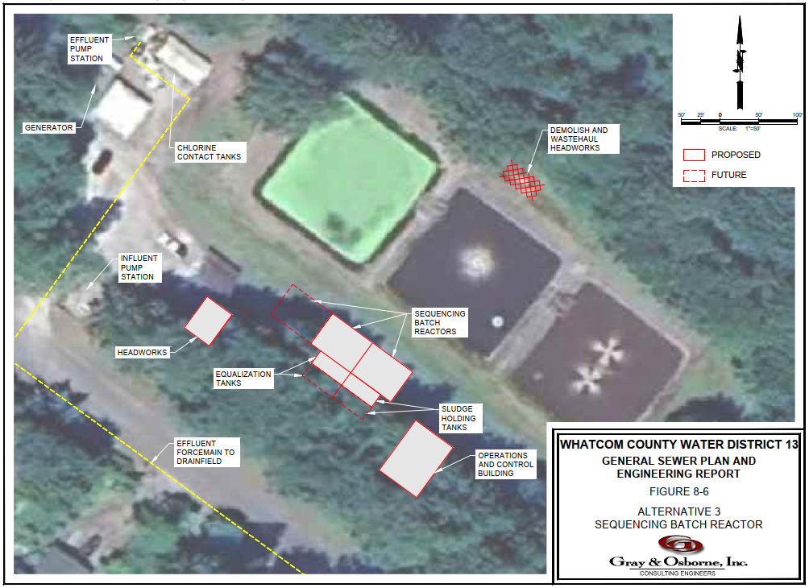
ALTERNATIVE 3 – SEQUENCING BATCH REACTOR (SBR)
Estimated
Capital Cost
$15.9 M

Slide 21
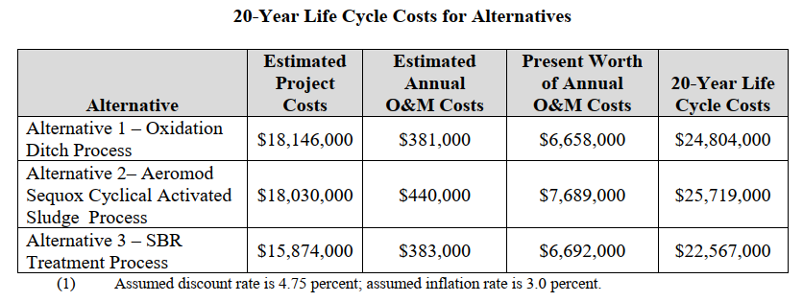
Life-Cycle Cost of Alternatives

Slide 22
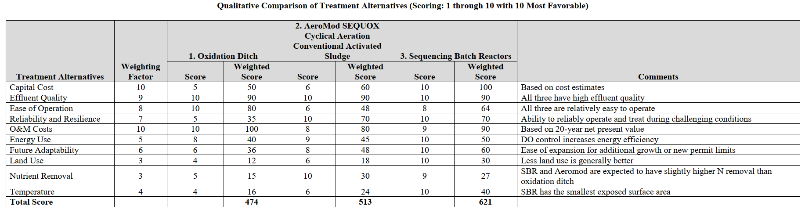
Evaluation of Alternatives

Slide 23
Capital Projects Cost
Project | Year | Cost (2025 dollars)
WWTP SBR Design | 2027-2028 | $1,500,000
WWTP SBR Construction | 2028-2029 | $14,374,000
Decommission Existing WWTP | 2029-2030 | $1,197,000
Upgrade GVLS | 2030 | $1,055,000
Total |  | $18,126,000

Slide 24
Funding and Rate Impacts
Monthly Sewer Rates per Connection
  2010 = $50
  2026 = $79
Sewer General Facility Charges (GFCs - paid by new connections)
  2010 = $3,125
  2012 = $12,266
  2026 = $16,592
Sewer Capital Project Reserves (GFCs + rate surplus)
  2010 = $0
  2026 = $769,000
Loans
  2008 Public Works Trust Fund (PWTF) = $100,000 (paid off in 2011)
  2024 Ecology Water Quality Combined Funding Program – Small Communities Priority Project List (SCPPL) - $345,000 low-interest loan w/ 50% forgivable principal to prepare General Sewer Plan/Engineering Report
RCAC (EPA-funded agency provides no-cost services)
  Income Survey – District qualifies for hardship
  Rate Study – to be completed in March 2026

Slide 25
Funding and Rate Impacts (con’t)
It is not possible to proceed without financial assistance
District will need significant assistance to afford a new WWTP
Grants are preferred/required
Pursuing WWTP Design Assistance:
  Additional SCPPL Grant / Loan
  Capital Budget Request (legislative ask)
  Whatcom County Economic Development Investment Board
  Federal legislative ask
  State Dept of Commerce – Local Government Capital Project Capacity Grant
  Public Works Trust Fund Grant / Loan

Slide 26
Next Steps
Complete Rate Study to determine specific impacts to rates/GFCs
Complete General Sewer Plan/Engineering report (April 1, 2026)
  Requires approvals from Ecology and Whatcom County
Host another Public Meeting
Secure Funding for Design & Construction
Complete Design of new WWTP (March 1, 2028)
Bid WWTP project (May/June 2028)
Construct new WWTP (start mid-late 2028, complete late 2029)
Decommission existing WWTP (2029-2030)

Slide 27
Questions

